Slide 1
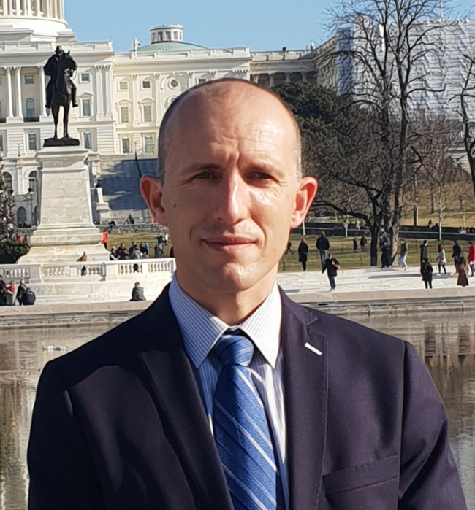
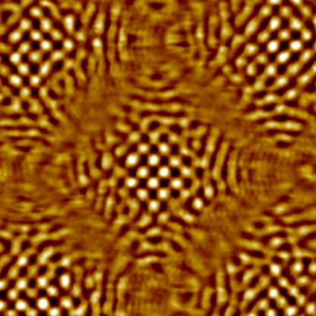
NANOENGINEERING AND BIOMATERIALS RESEARCH GROUP
Contact person/Group leader:
Prof. Dr. Bashkim Ziberi
Affiliation
Department of Physics, Faculty of Mathematics and Natural Sciences, University of Tetova
Mail address
Ilinden nn, 1200 Tetova, North Macedonia
Email/website
bashkim.ziberi@unite.edu.mk
Group Members
Prof. dr. Bashkim Ziberi, Prof. dr. Naim Mahmudi, Dr. Ramadan Aliti,
M.Sc. Nermine Muradi, Mbresë Selimi
Google Scholar
https://scholar.google.com/citations?user=yWSjOIwAAAAJ&hl=en
Research Gate
https://www.researchgate.net/profile/Bashkim_Ziberi
Research lines
Surface engineering of Si, Ge and III/V semiconductors using ion beams.
Self-organized formation and functionalization of nanostructured surfaces.
Hierarchical nano-structuring of surfaces by combining top-down and bottom-up techniques.
Mechanical properties and microstructural characterization of metal based alloys.
Synthesis and characterization of Polymers, Biopolymers and Hydrogels.
Nanoparticle aided Radiotherapy using Smartbiomaterials for targeted cancer treatment.
e
e
e
e
e

